Slide 1
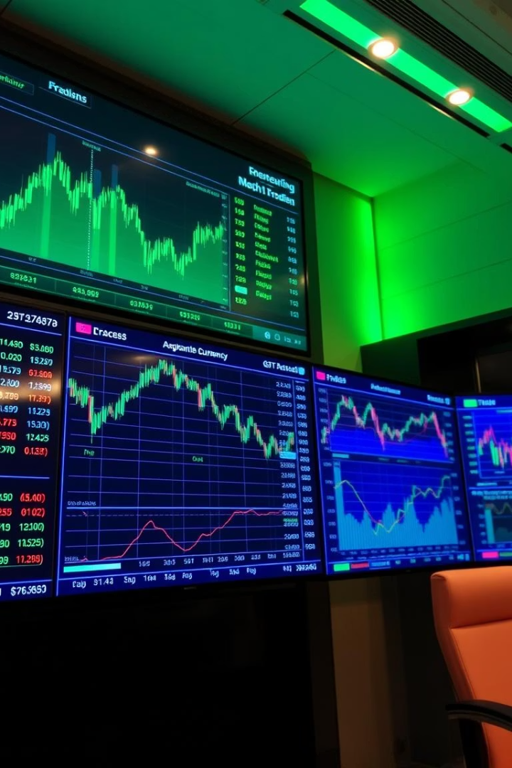

Exchange Rate Prediction with PSO-Optimized Neural Networks
Forecasting GBP/USD exchange rates using neural networks optimized by Particle Swarm Optimization.
by Amr Zohier

Slide 2
Project Overview and Objectives
Time series forecasting applied to financial markets.
Optimizing hyperparameters using Particle Swarm Optimization (PSO).
Predicting exchange rates with advanced neural network models.
Comparing traditional and PSO-optimized model performance.

Slide 3
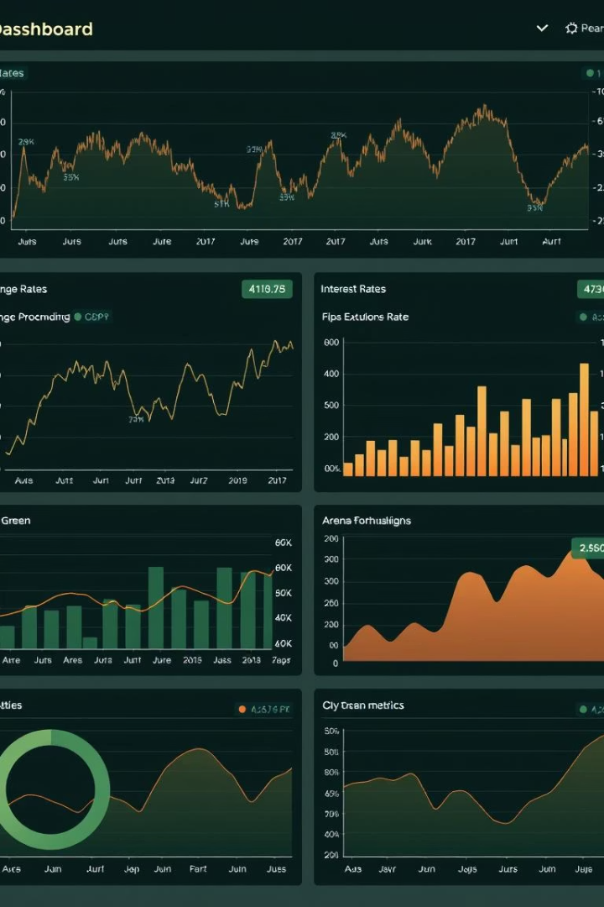
Data Sources and Time Frame
Federal Reserve Economic Data
OECD Statistics
Current account to GDP ratios.
Normalized GDP and Libor rates.
Forex Rates
Daily GBP/USD rates from 2001 to 2020.

Slide 4
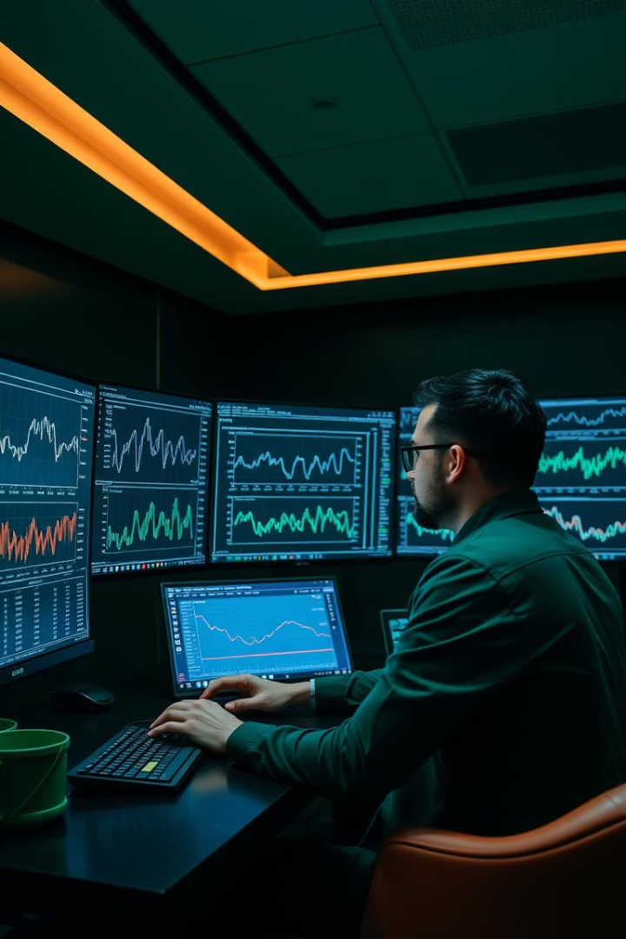
Data Preparation Methodology
Data Collection & Merging
Feature Engineering
Created lagged sequences to capture temporal dependencies.
Combined diverse datasets at different frequencies.
Train/Test Split
Reserving last 50 observations for rigorous testing.

Slide 5
Base Neural Network Models
Multilayer Perceptron (MLP)
Convolutional Neural Network (CNN)
Variable layers & neurons.
Conv1D and max pooling layers.
Early stopping for training.
Baseline RMSE: 0.03028.
Baseline RMSE: 0.01295.

Slide 6




Particle Swarm Optimization for Hyperparameters
PSO Algorithm Overview
Swarm intelligence to optimize neural hyperparameters.
Optimization Parameters
Number of layers and neurons.
Activation functions including Swish.
Dropout and learning rates.
Custom PSO Implementation
Tracks personal and global bests for convergence.

Slide 7
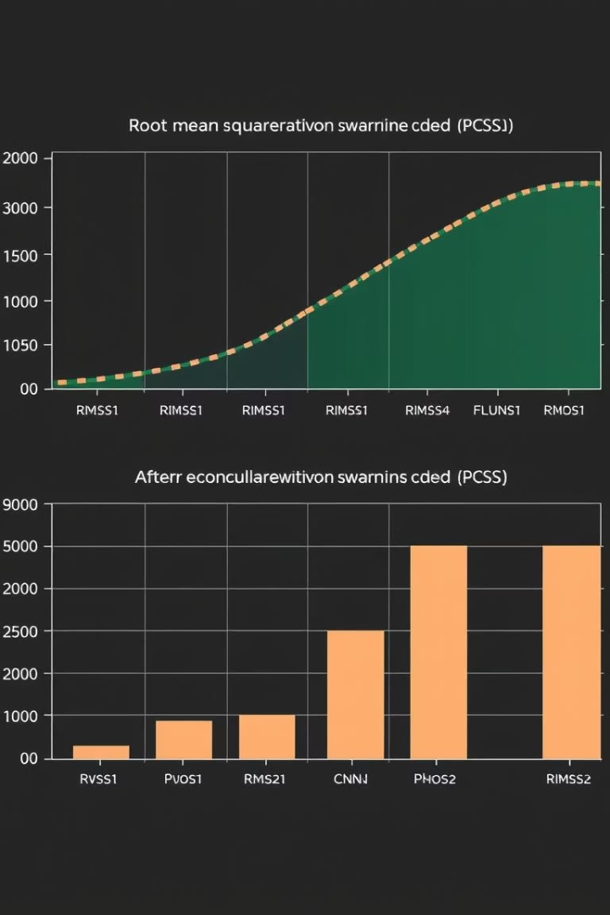
Performance Results and Comparison
Model
Baseline RMSE
PSO-Optimized RMSE
Improvement
MLP
0.01295
0.00708
45.33%
CNN
0.03028
0.00654
78.40%

Slide 8

Conclusions and Future Directions
PSO Impact
Significantly improves neural network forecasting performance.
Model Insights
Optimized CNNs outperform MLPs; Swish activation benefits noted.
Next Steps
Explore multivariate models, alternative optimizers, real-time prediction.

